Slide 1
Green Buildings Act Study
The Energy Efficiency Group
April 2024

Slide 2
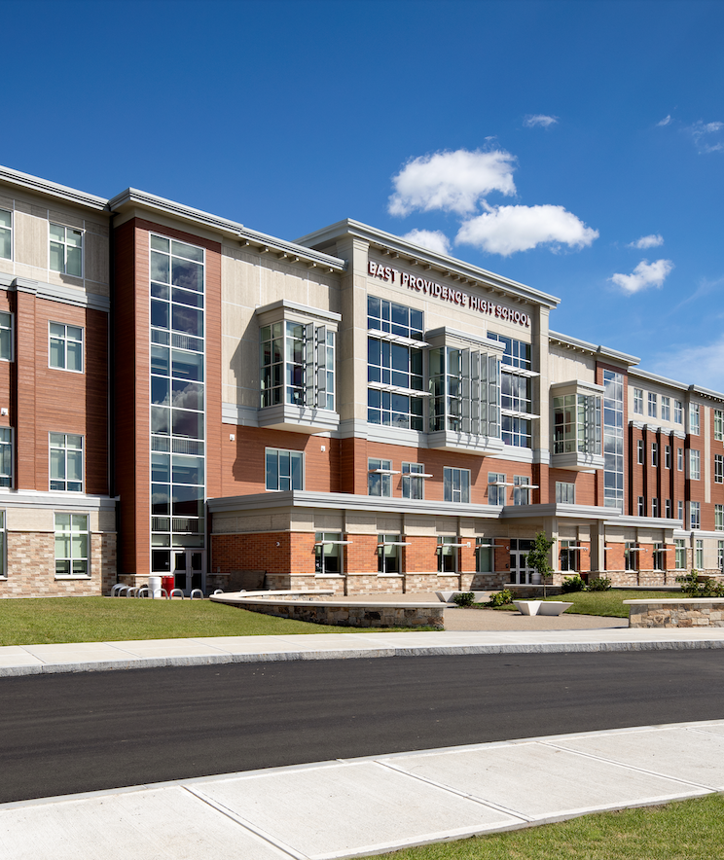
Agenda
Study Overview
Best Practices
Awareness & Evaluation
Methods
Findings
Recommendations & Next steps
Discussion
Image copyright Ai3 Architects

Slide 3
Study Overview
The Rhode Island Green Buildings Act Study was conducted to provide recommendations for the Green Buildings Advisory Committee (GBAC), drawn from best practices from the field for implementing similar legislation and evaluation of current awareness and application of the Act in Rhode Island.

Slide 4
Best Practices
Collected from 8 jurisdictions across the country
informational interviews
What was successful?
Clear mandates
Heavy investment in education of benefits of green buildings
Training gov. employees & tradespeople
Heavily networked across agencies
Clear metrics

Slide 5
Awareness & Evaluation: Methods
Assesses to what extent people and agencies in Rhode Island are working towards compliance with the Act
Uncovered barriers
30-60 minutes Interviews (8 interviews with 10 individuals)
Surveys
Sent to 432 people
14% response rate (28 completed)
Limitation of the study, could also indicate broader lack of compliance and awareness

Slide 6
Findings
Key finding: greater awareness and compliance is needed
Positive findings & strategies offered:
aligning GBA requirements with municipal or organizational goals
aligning GBA requirements with existing standards or those already in use, such as NECHPs
communicating compliance requirements with contractors, by including language outlining requirements in requests for proposals
planning compliance and engaging multiple stakeholders early in the process, such as bringing RI Energy into conversations during the planning stage

Slide 7
Findings (cont’d)
Straightforward key finding is there’s a gap in awareness and thus compliance
3 improvement areas:
Widespread education & awareness
Dedicated staff or resources to support compliance with the Act
Funding to support up-front costs for agencies.

Slide 8
4 Key Recommendations
​​Establish GBA Coordinator(s), as staff responsible for coordinating with public agencies to ensure compliance with the Green Buildings Act
Coordinate widespread awareness and education efforts across a variety of stakeholders
Create and communicate a clear path for verification that utilizes existing systems
Utilize incentives to support compliance, through funding for education, planning, and implementation

Slide 9
GBA Coordinator: Job Summary
Recommendation 1: ​​Establish GBA Coordinator(s), as staff responsible for coordinating with public agencies to ensure compliance with the Green Buildings Act
This coordinator(s) role is to address the three gap areas identified in the study:
Education & outreach (50%)
Funding guidance (30%)
Compliance process guidance (20%)

Slide 10
Education & Outreach
Recommendation 2: Coordinate widespread awareness and education efforts across a variety of stakeholders
Education & outreach is the majority of the GBA coordinator’s role (50%)

Slide 11
Compliance Process Guidance
Recommendation 3: Create and communicate a clear path for verification that utilizes existing systems
Have a go-to subject matter expert to guide agencies, contractors and facilities managers to appropriate resources to help achieve compliance and navigate the process of doing so
Help agencies determine project eligibility and provide guidance when navigating non-obvious applications and exemptions for compliance with GBA
Serve as liaison for connecting agencies to experts and specialists (i.e. LEED APs, grant writers, architects, builders, and contractor. recommendations)
Direct agencies to appropriate resources and experts when questions arise (i.e. a central compliance website or form, documented examples of compliance with GBA)
Create a community and culture of peer learning; build a culture that supports prioritizing GBA compliance because it benefits the agencies

Slide 12
Funding Guidance
Recommendation 4: Utilize incentives to support compliance, through funding for education, planning, and implementation
Identify funding to support stakeholders’ upfront costs
Funding education of where to receive financial support
Answer questions & assist agencies in navigating the process

Slide 13
Discussion
How do you see the committee getting involved with the recommendations (education & outreach, staff support, funding support)?
How do you see your role at your organization (or as an individual) playing a part in carrying out these recommendations?
Is there anything that we as a committee should consider as a key next step that is not included in the study?

